Slide 1
Facilities Bane or Gain? Driving Value to the Bottom Line through a Robust Facility Management Program
CMAA World Conference
February 21st, 2016
John Rimer, CFM
FM360consulting.com

Slide 2
Introduction
John Rimer, CFM
18+ Years Facility Management
Numerous Industries & Various Roles
Owner, FM360 Consulting
Certified Facility Manager (CFM) - IFMA
IFMA & BOC Qualified Instructor
IFMA City & Country Clubs Council
Supporting facility professionals since 2009
50+ worldwide members
Education, Knowledge Sharing, Benchmarking, & Best Practices

Slide 3
Agenda
Define O&M
Value of a Robust Maintenance Program
Identify Criticality & Priorities
Scheduling & Managing (CMMS)
Assess & Analyze (KPIs)
CCCC Upcoming Annual Meeting
Q&A

Slide 4
On-Going Club Challenges
Increasing Net Membership
Member Utilization & Satisfaction
Changing Member Requirements
Budget Management & Constraints
Facilities are at the core of these challenges
Bane or Gain?
Notes:
Facilities – either working with you or against you…

Slide 5
Facilities are Core
Club facilities & grounds provide
Venue and Activities
House & Host Events
Provide Services
Set Tone & Atmosphere
Communicate a Message
What do your facilities communicate?

Slide 6
What do your facilities communicate?
Walk in their shoes
What do you see, hear, feel, & smell
From the parking lots to the greens, the lobby to the lavatories
Represent the prestige?
Build upon the heritage?

Slide 7
Challenges of FM
Shrinking Skilled Labor Pool
Most maintenance organizations operate between 10% to 40% efficiency (MT-Online)
Most spend >50% time on emergency work (FacilitiesNet)
Top Challenge – 39% Aging Infrastructure (FM360 survey)

Slide 8
No More Firefighting
Cost of Reactive Maintenance
RM Costs 3X to 5X more than PM (MT-Online)
DOT Study found 8X higher costs
Market Image
Member Retention
Employee Burn-Out
Lost Productivity/Revenue
Notes:
Cheaper to change oil…

Slide 9
What is a Robust Program?
Fundamental Components
Clear Vision/Mission
Capital Reinvestment Planning
Project Management
Operations & Maintenance
Emergency Preparedness

Slide 10
Value of a Robust Program
Increase Member Satisfaction
Double Productivity of Staff (IFMA)
Reduce Maintenance Costs by as much as 50% (Piper/FacilitiesNet)
Reduce Energy Use by 15% - 20% (Piper/FacilitiesNet)

Slide 11
Clear Strategy
Defined Vision/Mission
Adopted at all levels
Exemplified by Leadership
Collaborative Initiative
FM at the table
Be your right-hand
Established Direction
Unified effort
Notes:
How well do you communicate with and involve your FM

Slide 12
Gap Analysis
Assess Program & Buildings
Identify strengths & weaknesses
Review current operations
Staffing models & skill sets
Facility condition assessment
Budget benchmarks
Notes:
All feed into a strategic plan that aligns with vision/mission

Slide 13
Capital Reinvestment Plan
1/3/5/10-year forecast
Steady-state spend
Manageable & predictable
Put in context of Master Plan
Update annually
FCA (in-house/outsource)
Manage in CMMS

Slide 14
Project Management
FM involved/led
Sufficient Planning
Due diligence
Historic facilities
Successful Execution
Commissioning (Cx)
13% to 25%+ energy savings
Increased occupant satisfaction
Thorough Documentation
Accurate drawings, manuals, etc.

Slide 15
Operations & Maintenance
Reactive or Proactive
Ideally 80/20 PM to CM ratio
Where to Start
Assign criticalities/priorities
Driven by vision/mission
Identify maintenance strategies
Determine who performs maintenance
Needed skill sets
In-house vs. outsource
Leverage technology
PdM, BMS, Energy Management
Manage work & assets in CMMS

Slide 16
CMMS
Computerized Maintenance Management System
Efficiently manage staff & workload
Prioritize work orders
Right maintenance, right time
Track asset costs
Improve communication
Staff & members
Mobile technology
Coordinate events

Slide 17
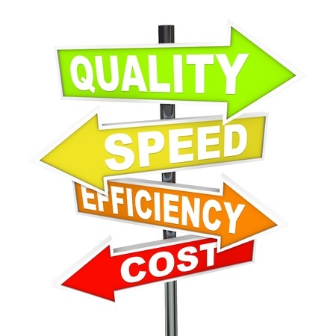
CMMS
Track & manage projects
Assist with budget development
Ops & CapEx (CRP)
Measure performance
KPIs
Identify opportunities for improvement
Member comfort & satisfaction
Cost reductions
Relatively inexpensive
Cloud-based

Slide 18
Emergency Preparedness
Risk Management
Proactive
Communication
Escalation protocol
Incident Management
Emergency Preparedness
EOPs
Training
Drills
Reiterates Safety is #1

Slide 19
City & Country Clubs Council
Encourage your FMs to join!
http://clubs.ifma.org/
Attend upcoming Annual Meeting
March 13th – 16th
At The Ridgewood Country Club
Paramus, NJ
Registration Deadline: February 29th

Slide 20
Questions?
John Rimer, CFM
john@fm360consulting.com
FM360consulting.com
The Resource for Facility Industry Consulting & Training

